Slide 1

GROUP A PRESENTATION
KASI LINK-UP

Slide 2
KASI LINK-UP
YOUR ARE NEVER FAR FROM THE MARKET

Slide 3


LITERATURE
Research shows that:
Late payments, economic fluctuations, and unexpected expenses often strain small businesses, affecting their ability to invest in growth and innovation
Local entrepreneurs grapple with finding a balance between survival and expansion in an uncertain economic landscape.Crime rates pose a significant
threat to businesses. Theft, vandalism, and security concerns affect both physical stores and online operations.

Slide 4





PROBLEM STATEMENT
LACK OF RESOURCES
WRONG PLATFORM
LACK OF FORMAL EDUCATION
Small businesses don’t have enough resources to make it to large areas. They use social media to promote their business because it is free but it is also hard to get to the target audience due to many defferent content being share on the same platform
Small businesses owners struggle to target their audience because they don’t have the right platform where they can promote their business.They also can’t get customers due to competition from large companies that have a higher budget and enough resources to promote their business.
Small businesses lack support due to the fact that most of them are owned by people who lack formal education to start a formal business but they have the skill required to do the work.

Slide 5
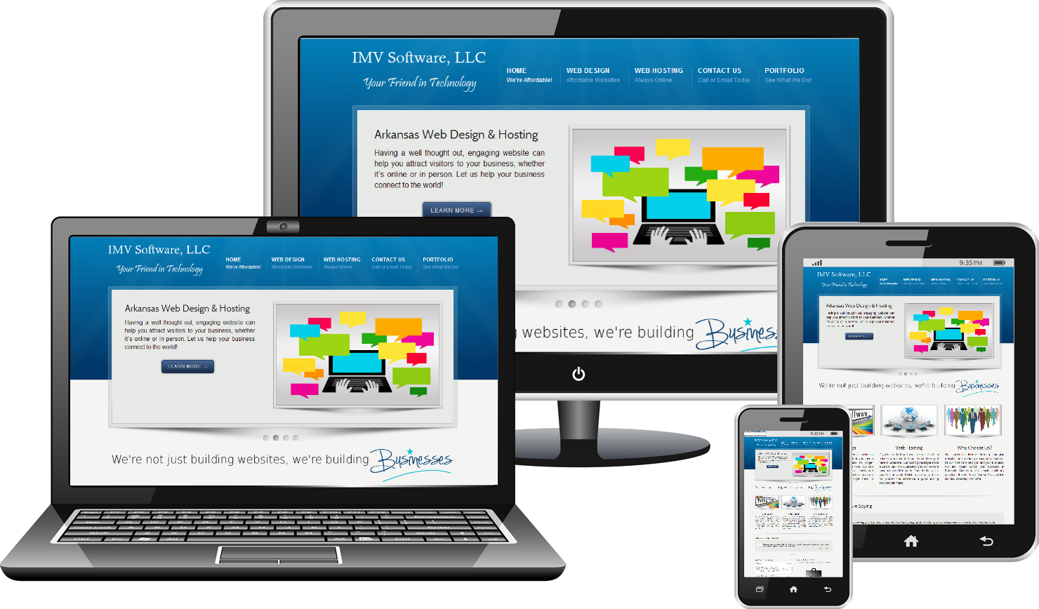
SOLUTION
Small businesses owners can create detailed profiles that will show thier products, services, and other stuffs that the business provide. This platform will help them get their target audience due to their profiles.
Our platform offers robust targeting capabilities, allowing businesses to tailor their marketing campaigns to specific demographics, interests, and behaviors. This ensures that their messages resonate with the right audience, leading to higher engagement and conversion rates
The solution for the problem being faced by small businesses owners is to create a website that is dedicated to them so they can have a platform that is for business promotion only unlike social media(facebook,twitter,whatsapp and Instagram).
This platform will be the solution for the gap between businesses and customers, it will give business owner an environment where they can promote their businesses.

Slide 6

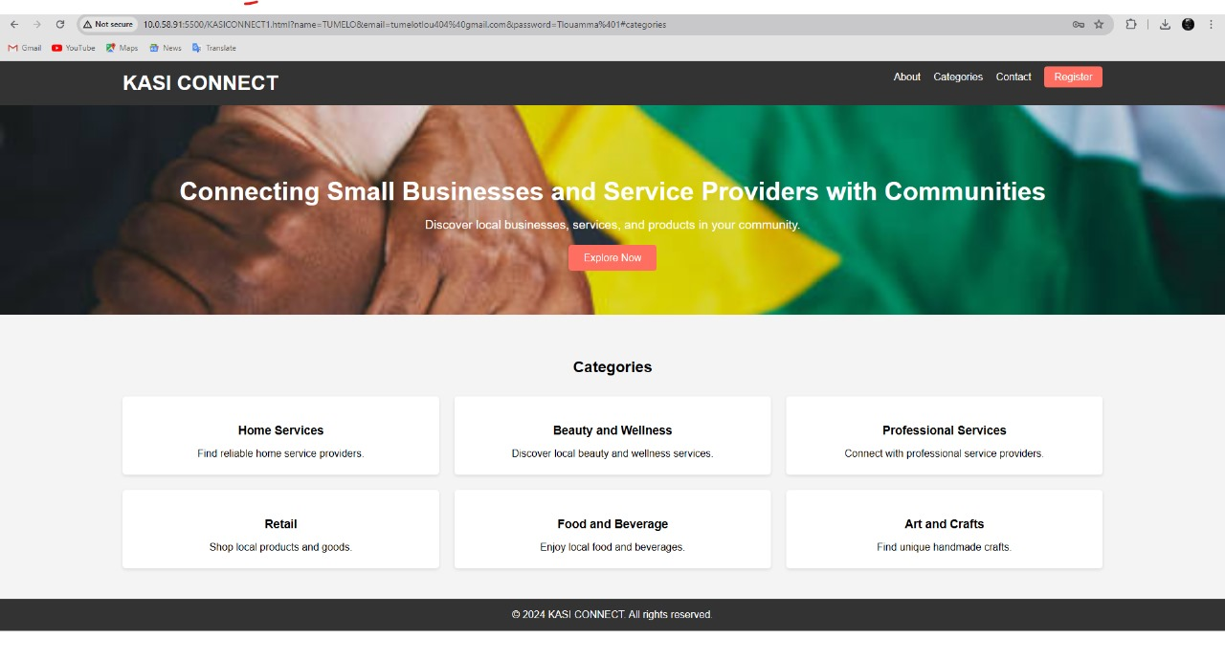

Slide 7
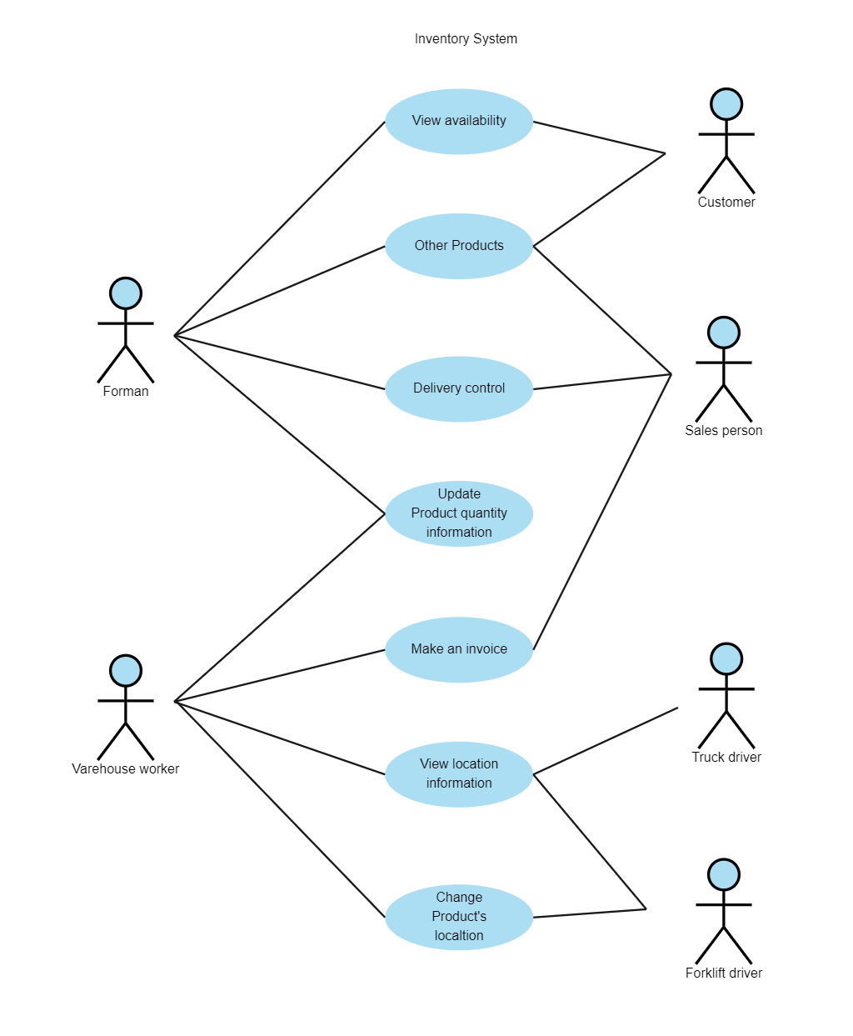

USE-CASE DIAGRAM

Slide 8

TOOLS THAT WE USED FOR SOFTWARE DEVELOPMENT
INTEGRATED DEVELOPMENT ENVIROMENT:
Visual Studio code
FRONTEND:
HTML
CSS
BACKEND:
Node.js
Express.js
DATABASE:
MongoDB

Slide 9
conclusion
In closing, our presantation today was to come up with a solution that is faced by local businesses. We created a website that can empower local businesses. We’ve discussed the challenges they face, the evidence supporting our solution, and the possible steps we propose. As we conclude, remember that this platform isn’t just about commerce; it’s about community. By collaborating and leveraging technology, we can uplift our local entrepreneurs, foster economic growth, and create lasting impact. Thank you for joining me on this journey, and I look forward to seeing our vision come to life supported by you.

Slide 10


